Slide 1
Behind the scenes of QGIS.ORG
A brief story of passion, challenges & opportunities

Slide 2
QGIS started 2002 as a Postgis viewer and today it is ...
… the most popular Open Source Desktop GIS
... the second most popular GIS after ESRI ArcGIS
… Partially translated in 88 languages (18 more than 75%)
… available for Linux, Windows, MacOS and apps for Android, Windows and iOS
… released every 4 months with LTR releases every year
… an amazing cartography toolkit with Atlas and report generation
… a powerful analysis and model builder platform with Processing
… a mobile data collection solution (QField, Mergin Maps, Roam)
… a platform for developers to build custom solutions
… an OGC server with ease of use for styling, labeling and printing data
… comes with several web clients: QWC 2, LizMap, GISQUICK and more

Slide 3
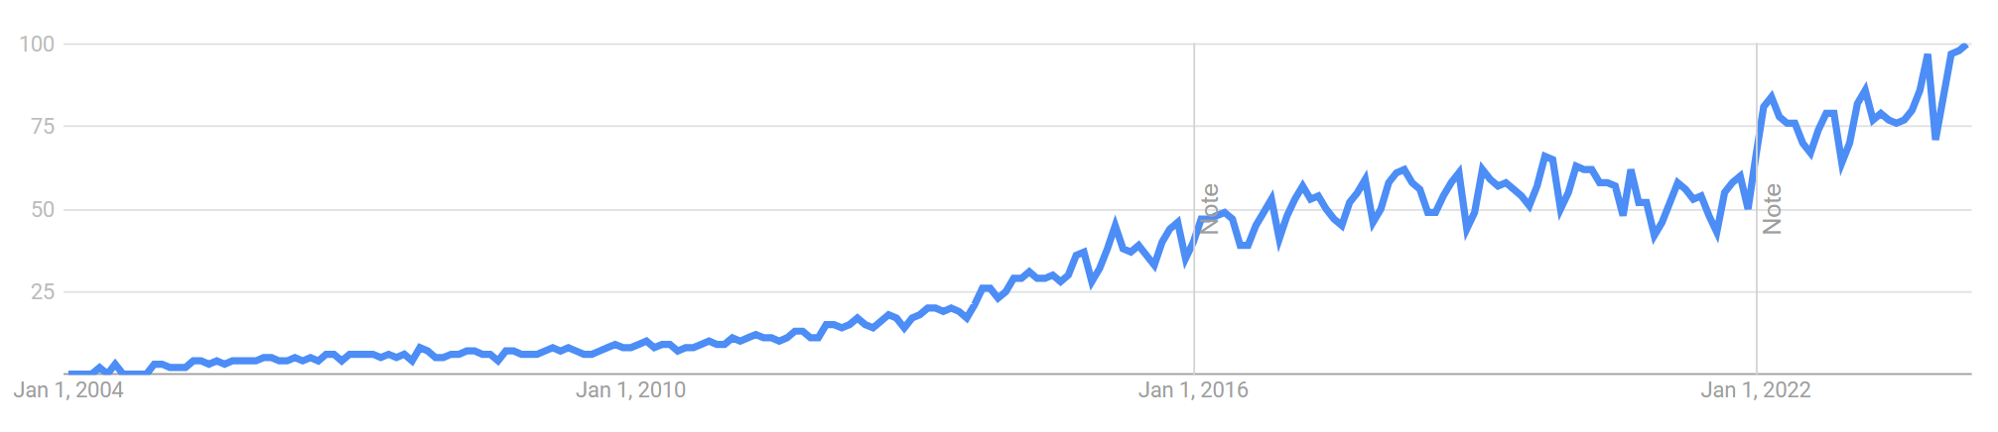
QGIS History & Key Events
Website v3 launch
1st flagship sustaining member
QGIS.ORG Association founded
QGIS 3.0
1st QGIS User Conference in Nødebo
QGIS 3.4 (first 3.x LT version)
OSGEO incubation, Introduction of PSC
1st QGIS user group founded in Switzerland
QGIS 3.18
QGIS 2.0 (Dufour)
1st Windows release
QGIS 1.0 (Kore)

Slide 4
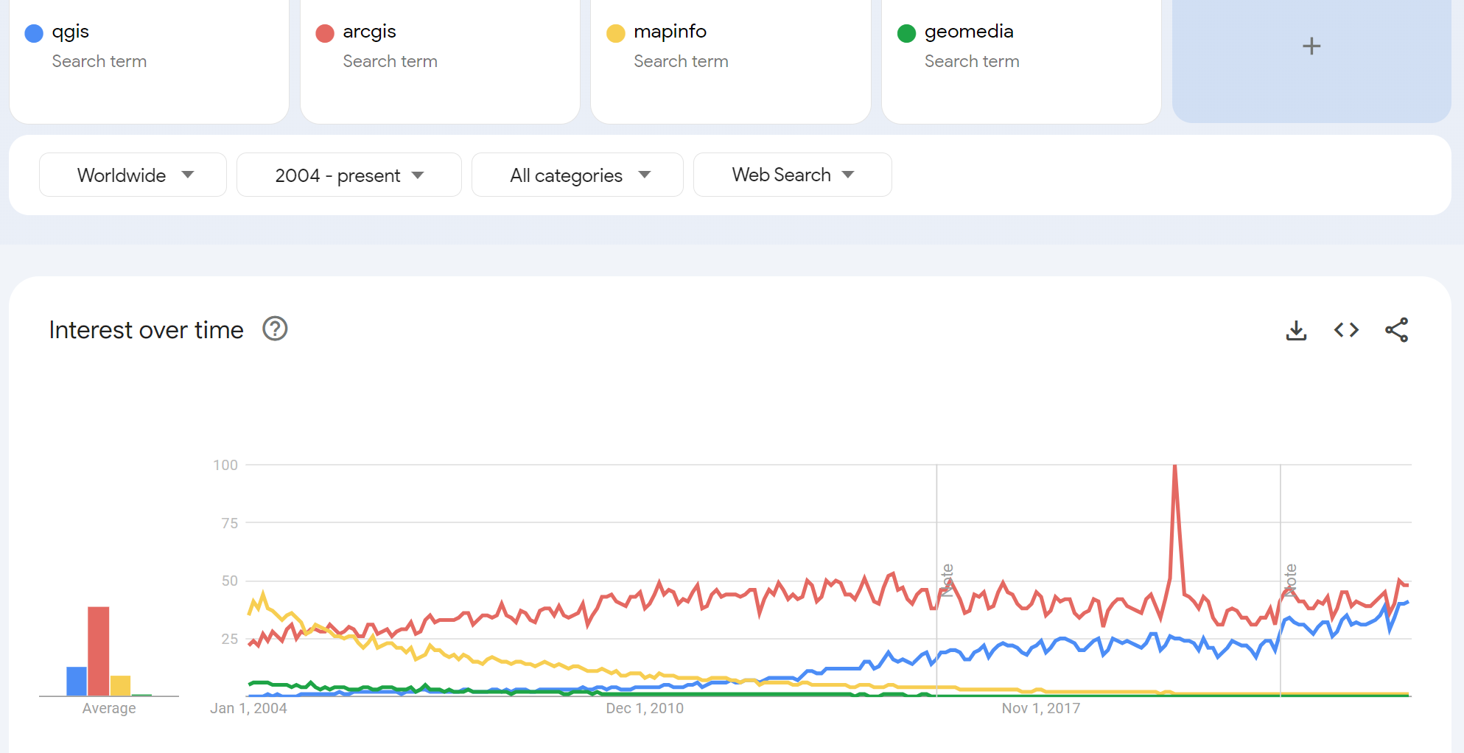
Search volume on Google (worldwide)
https://trends.google.com/ (09.04.2024)

Slide 5
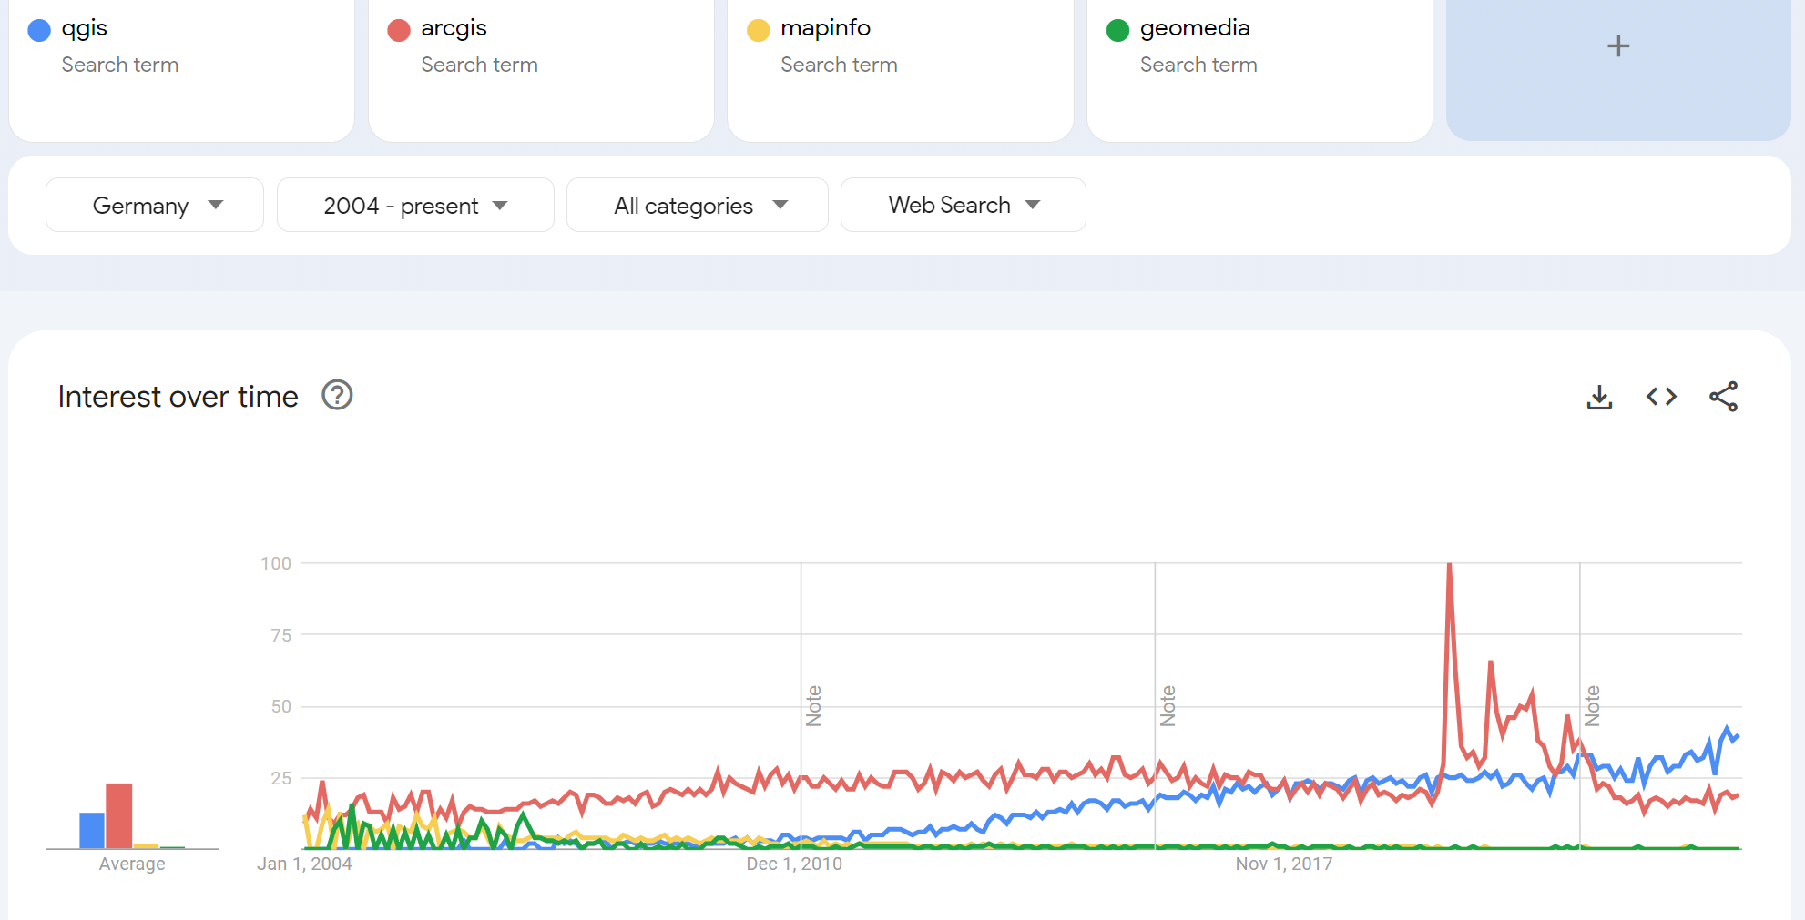
Search volume on Google (Germany)
https://trends.google.com/ (09.04.2024)

Slide 6
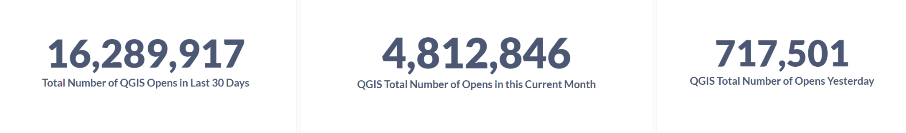
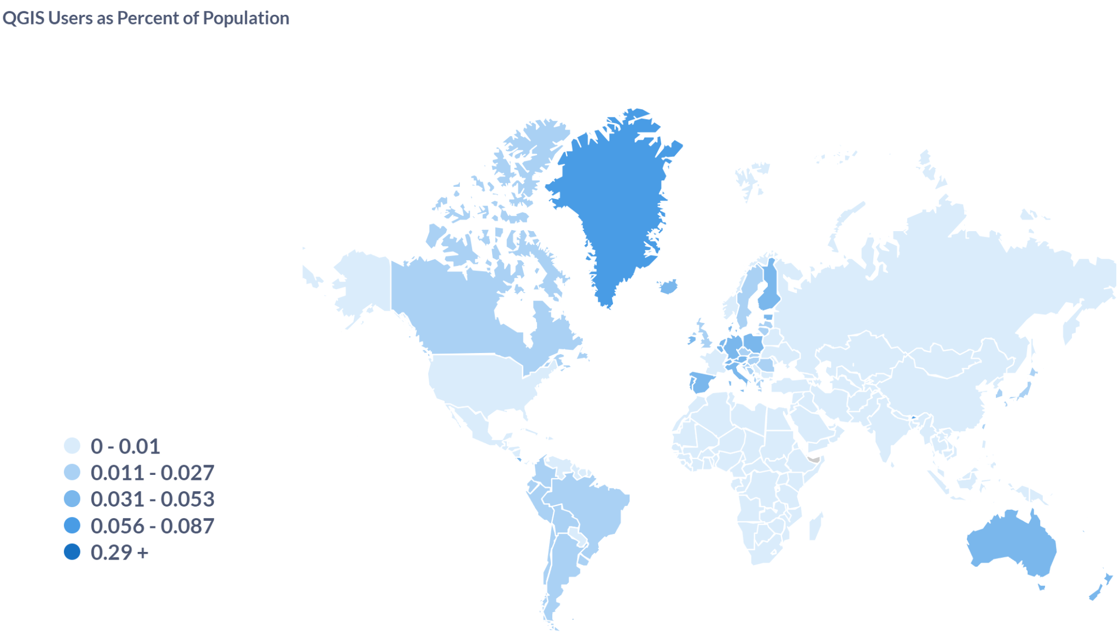
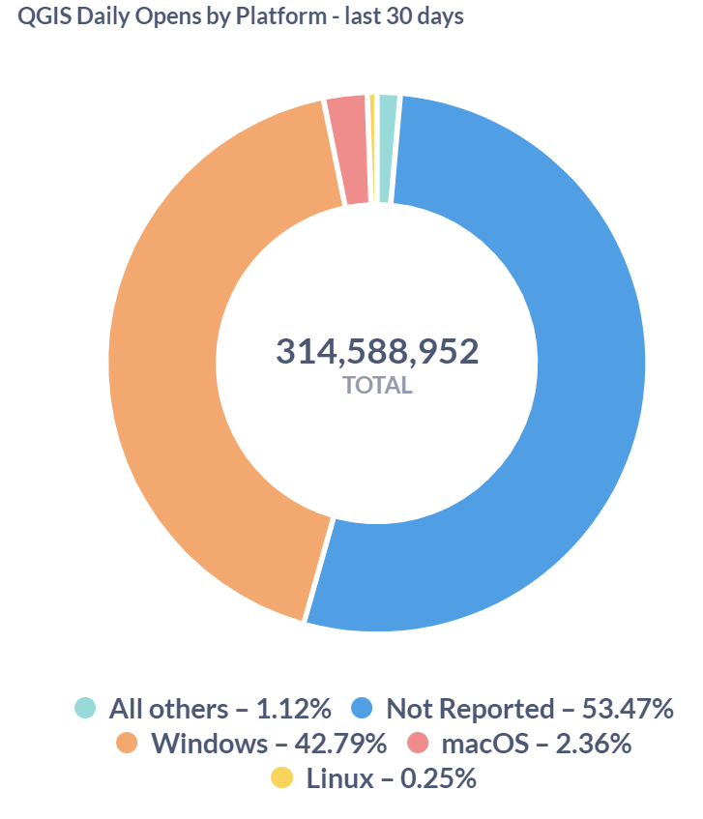
QGIS User Statistics
https://analytics.qgis.org (09.04.2024)

Slide 7
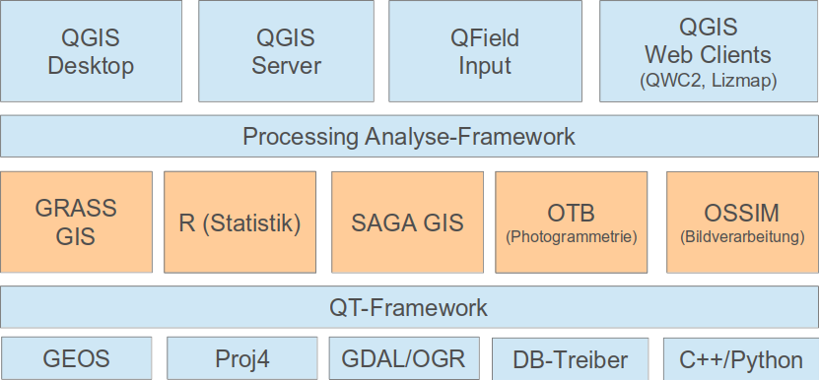

QGIS Ecosystem
Mergin Maps
QWC, G3W, Lizmap, QGIS WASM
Processing Analysis Framework
R
OTB
PCRaster
QT Framework
DB Drivers

Slide 8
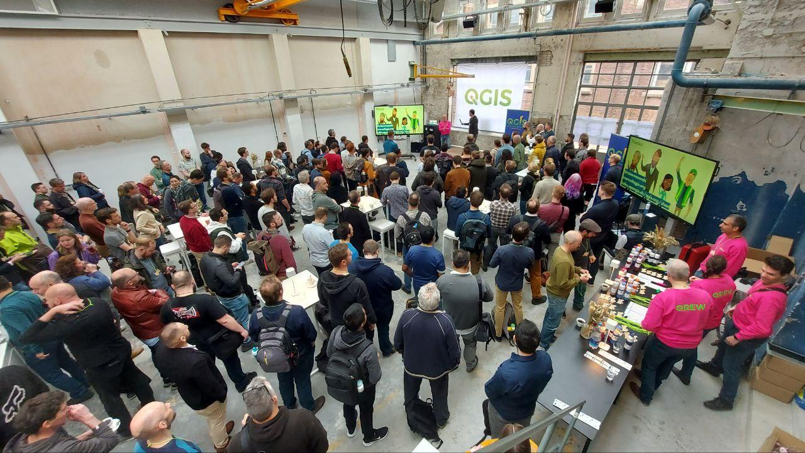
So what makes QGIS a success?
It’s the people!
It’s you as a user and
you as a contributor!
… and it’s the Internet and collaboration tools that we can use.

Slide 9
So what are these people contributing?
Testing & submitting bug reports
Documenting, creating training materials
Translating QGIS, incl. documentation
Developing new features
Fixing bugs & issues
Maintaining the IT infrastructure
Maintaining Github issues & PR queue
Reviewing developer contributions
Maintaining CI (Continuous Integration)
Releasing QGIS & packaging
Teaching QGIS, creating courses
Reviewing training material and certificates
Sharing resources like styles, symbols 3D modes, processing models
Writing plugins
Managing plugin submissions
Donating & memberships
Accounting
Membership management
Running user groups
Organizing local events
Organizing dev meetings
Helping other users on
Social media & PR
Hosting QGIS Open Days
Tutoring new contributors for all of the above tasks

Slide 10
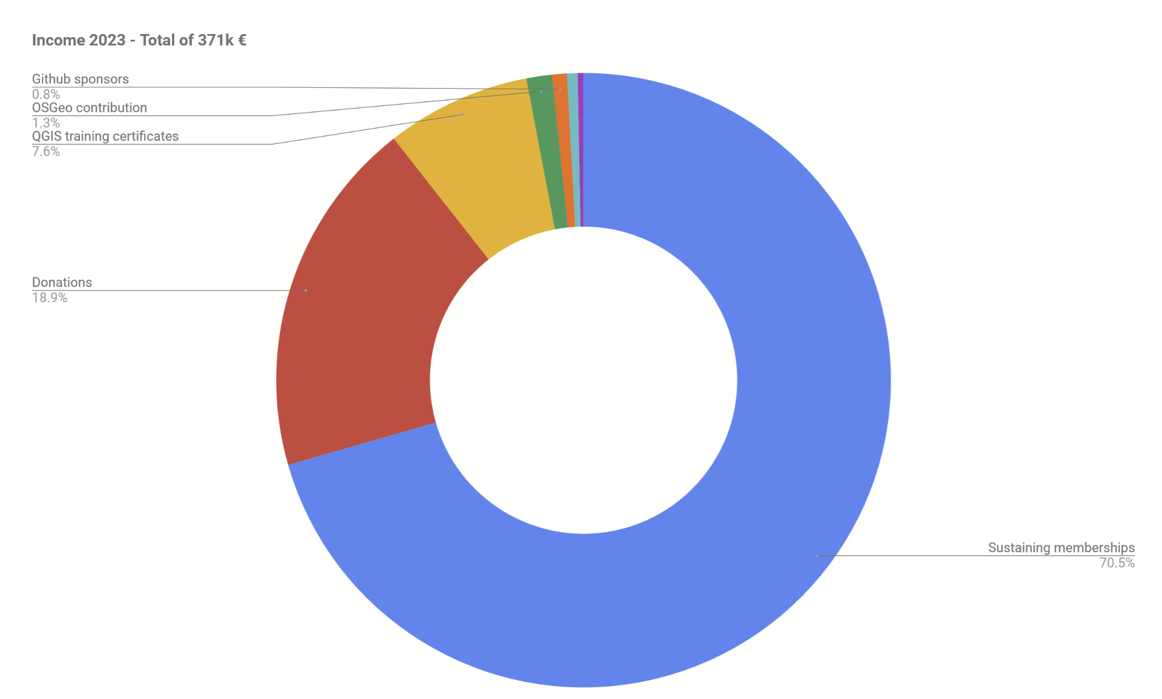
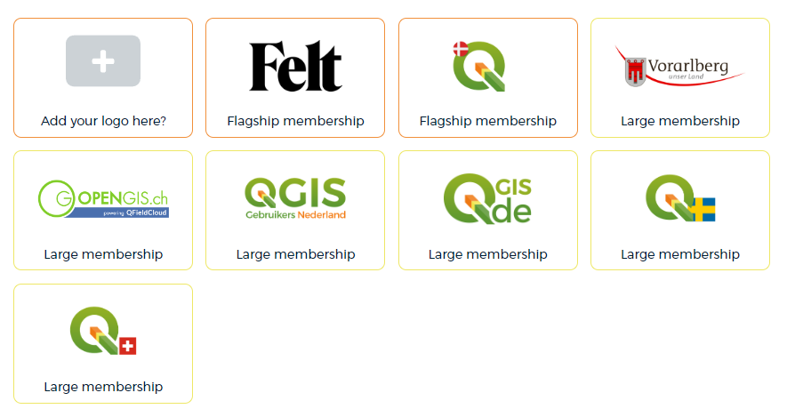
Budget – Income

Slide 11
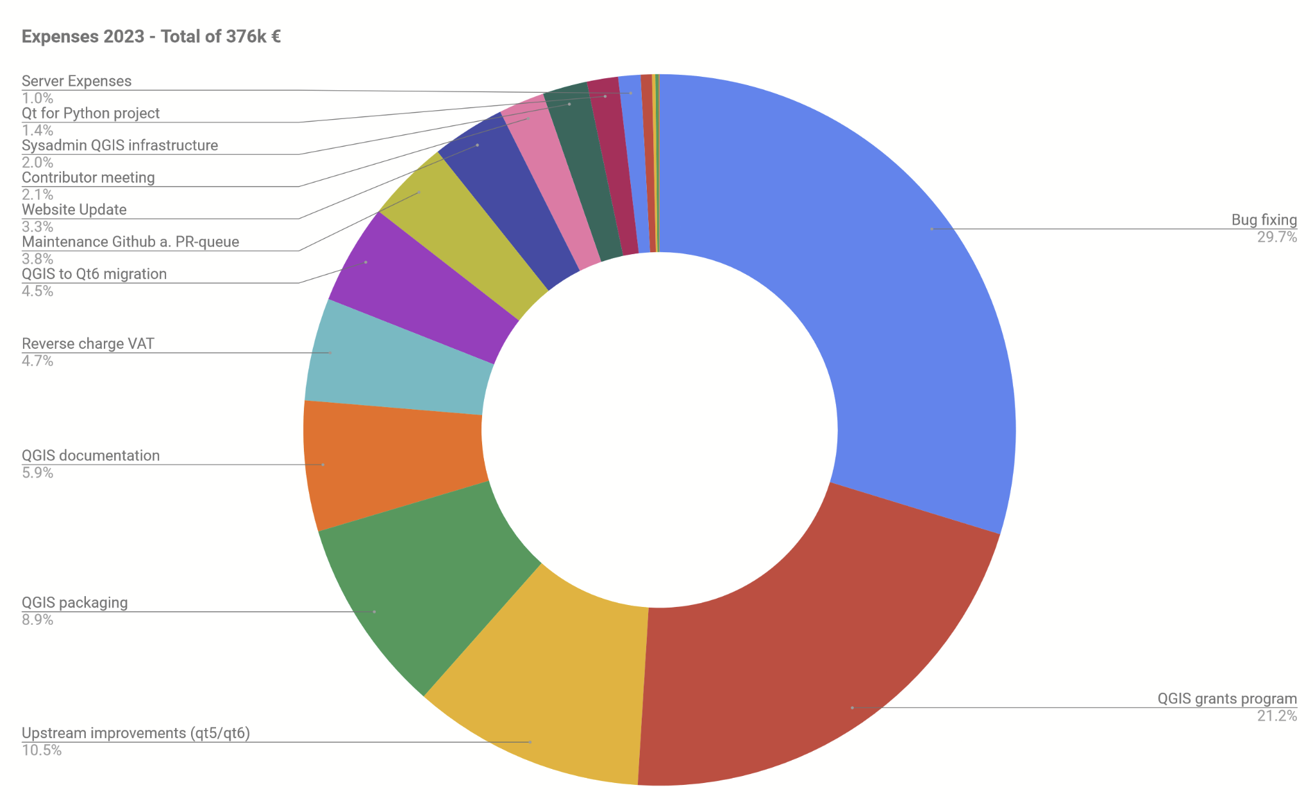
Budget – Expenses
Fullstack dev (Lova) added in 2023
New website work commissioned
Professional documentation writer (Selma) added in 2023

Slide 12


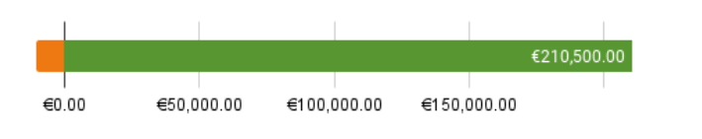
Budget
Crowdfunding 2023
42 new sustaining members
(incl. 2 universities on medium level)

Slide 13
Sustain us
Sustaining membership
27,000+ € / Year Flagship Member
  e.g. for companies larger than 100 employees, federal governmental organizations
9,000+ € / Year Large Member
  e.g. for larger cities, provinces or companies up to 100 employees
3,000+ € / Year Medium Member
  e.g. for universities, medium size cities or companies up to 50 employees
500+ € / Year Small Member
  e.g. for smaller cities or companies up to 10 employees
Your funds have a huge multiplier effect, putting QGIS into the hands of people
in the developing world who could never afford an proprietary GIS license

Slide 14
Sustain us
Donations
Any amounts
Tax-deductible in some countries
Workforce
Commit employees work-time for maintenance (PR, Bug fixes, documentation, translation, …)
Gift developer time to the project

Slide 15
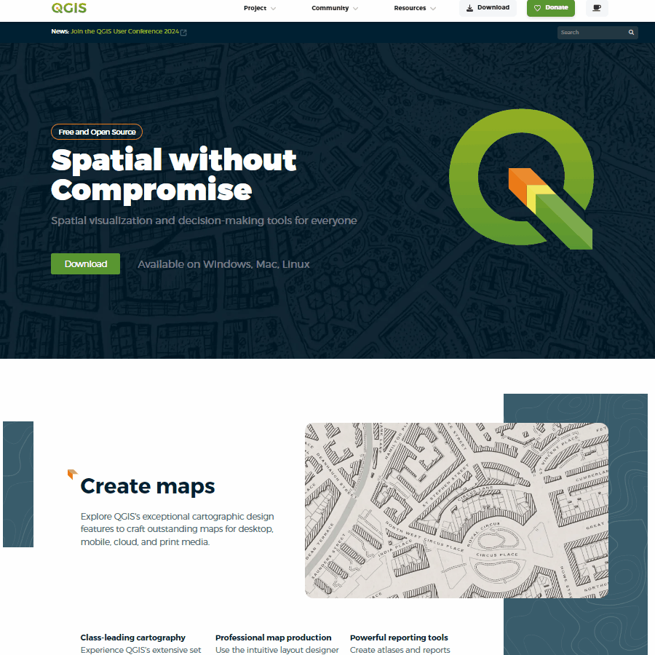
New Website
In-house development started at FOSS4G 2022 Florence
Professional development by Kontur.io from 2023
Launched in July 2024
Harmonization of other sites
is still ongoing

Slide 16
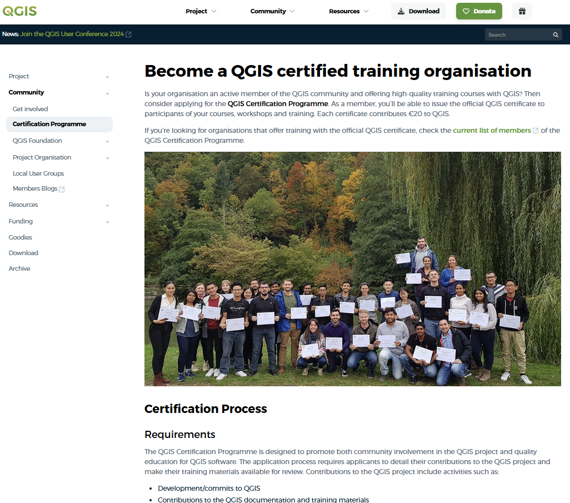


Certification
Organisations that
  Contribute to QGIS
  Have high quality materials

Slide 17
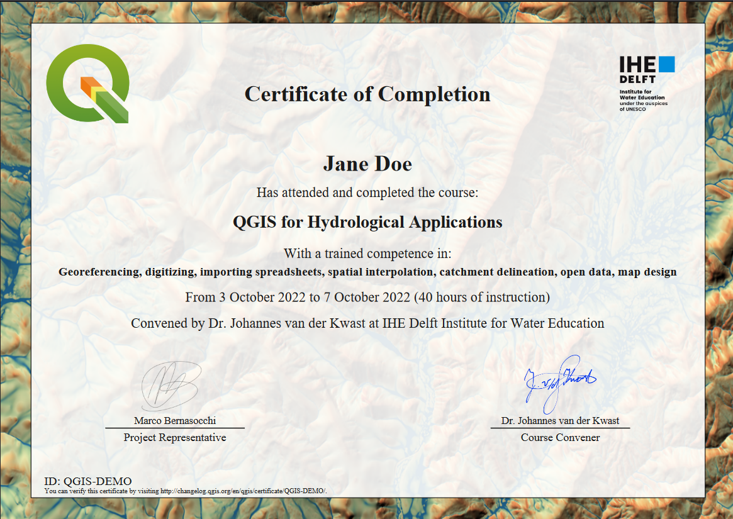

Slide 18

















Infrastructure Management

Slide 19
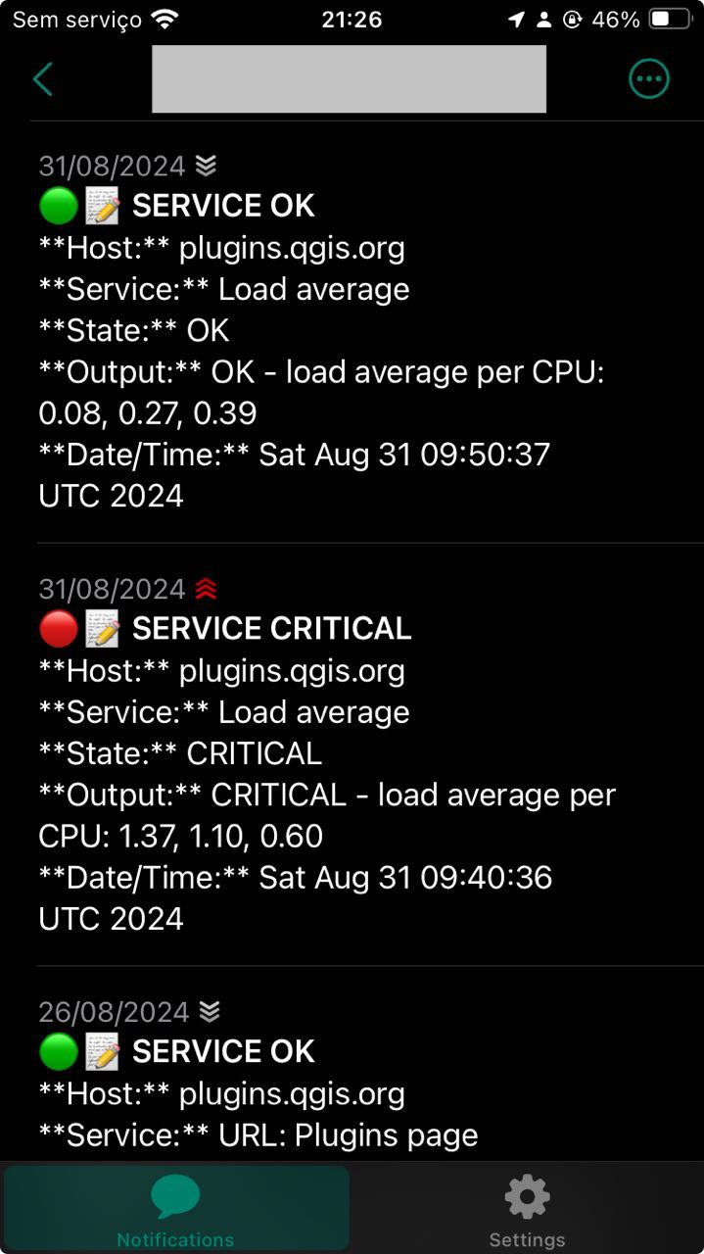
Infrastructure Management
Physical servers at Hetzner (Germany):
Dedicated servers for: plugins, feed, headscale, qgis.org, nagios
Building documentation & debian packages
Dedicated machine for running tests (http://test.qgis.org/)
Backup box
Additional servers at:
Kartoza: Projecta (changelogs, sponsors, training certificates)
Norbit: Windows builds
Apple machines for builds
We are in a process of redeploying almost all services on machines which are clearly documented, monitored, locked down for better security etc.
External Services we use:
Cloudflare for CDN and DNS
Github for versioning
Github for issue tracking (documentation and website)
Github and Travis CI (continuous integration)
Docker: plugins.qgis.org, documentation, website, stripe
Jitsi for video conferencing (PSC meetings)
Google Docs for exchanging data and collaboratively editing of documents
Fosstodon, Wordpress (Blogs), StackExchange
Stripe and PayPal for donations and credit card payments for sponsorships

Slide 20
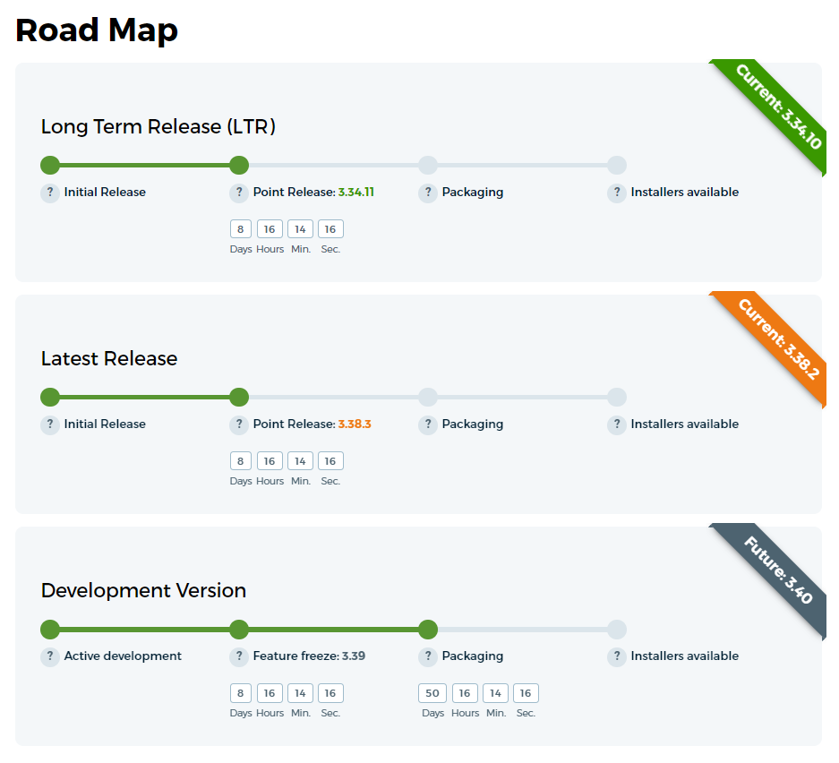
QGIS Release Management
Time-based schedule (roadmap):
A new release will happen every four months. In the first three months, new development is taking place. In the last month before a release, a feature freeze is invoked and the final month is used for testing, bug fixing, translation and release preparations.
Even versions (2.18, 3.2 etc) are release versions.
Odd versions (2.99, 3.1 etc) are development versions.
Every third release (starting with 2.8) is a long-term release (LTR) that is maintained until the next long-term release occurs.

Slide 21
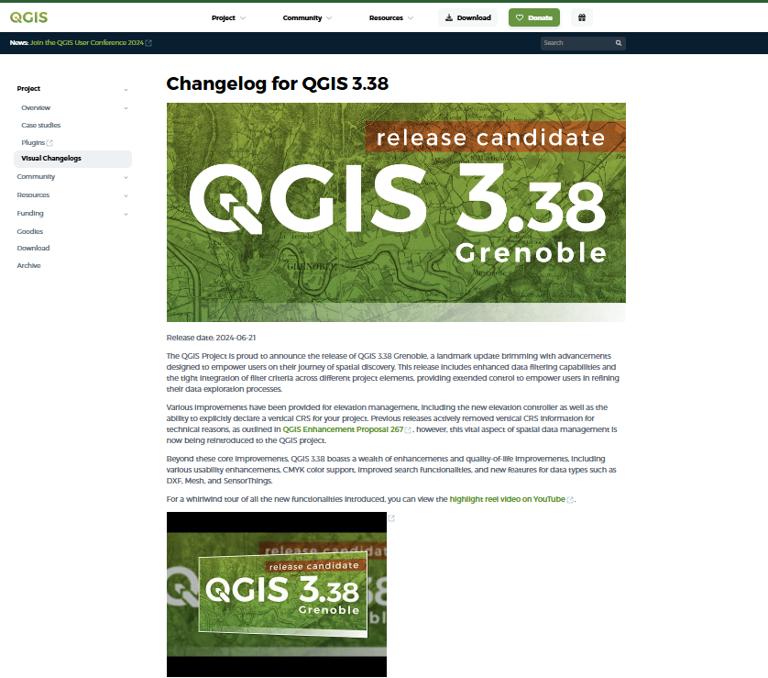
Visual Changelogs
https://qgis.org/project/visual-changelogs/

Slide 22
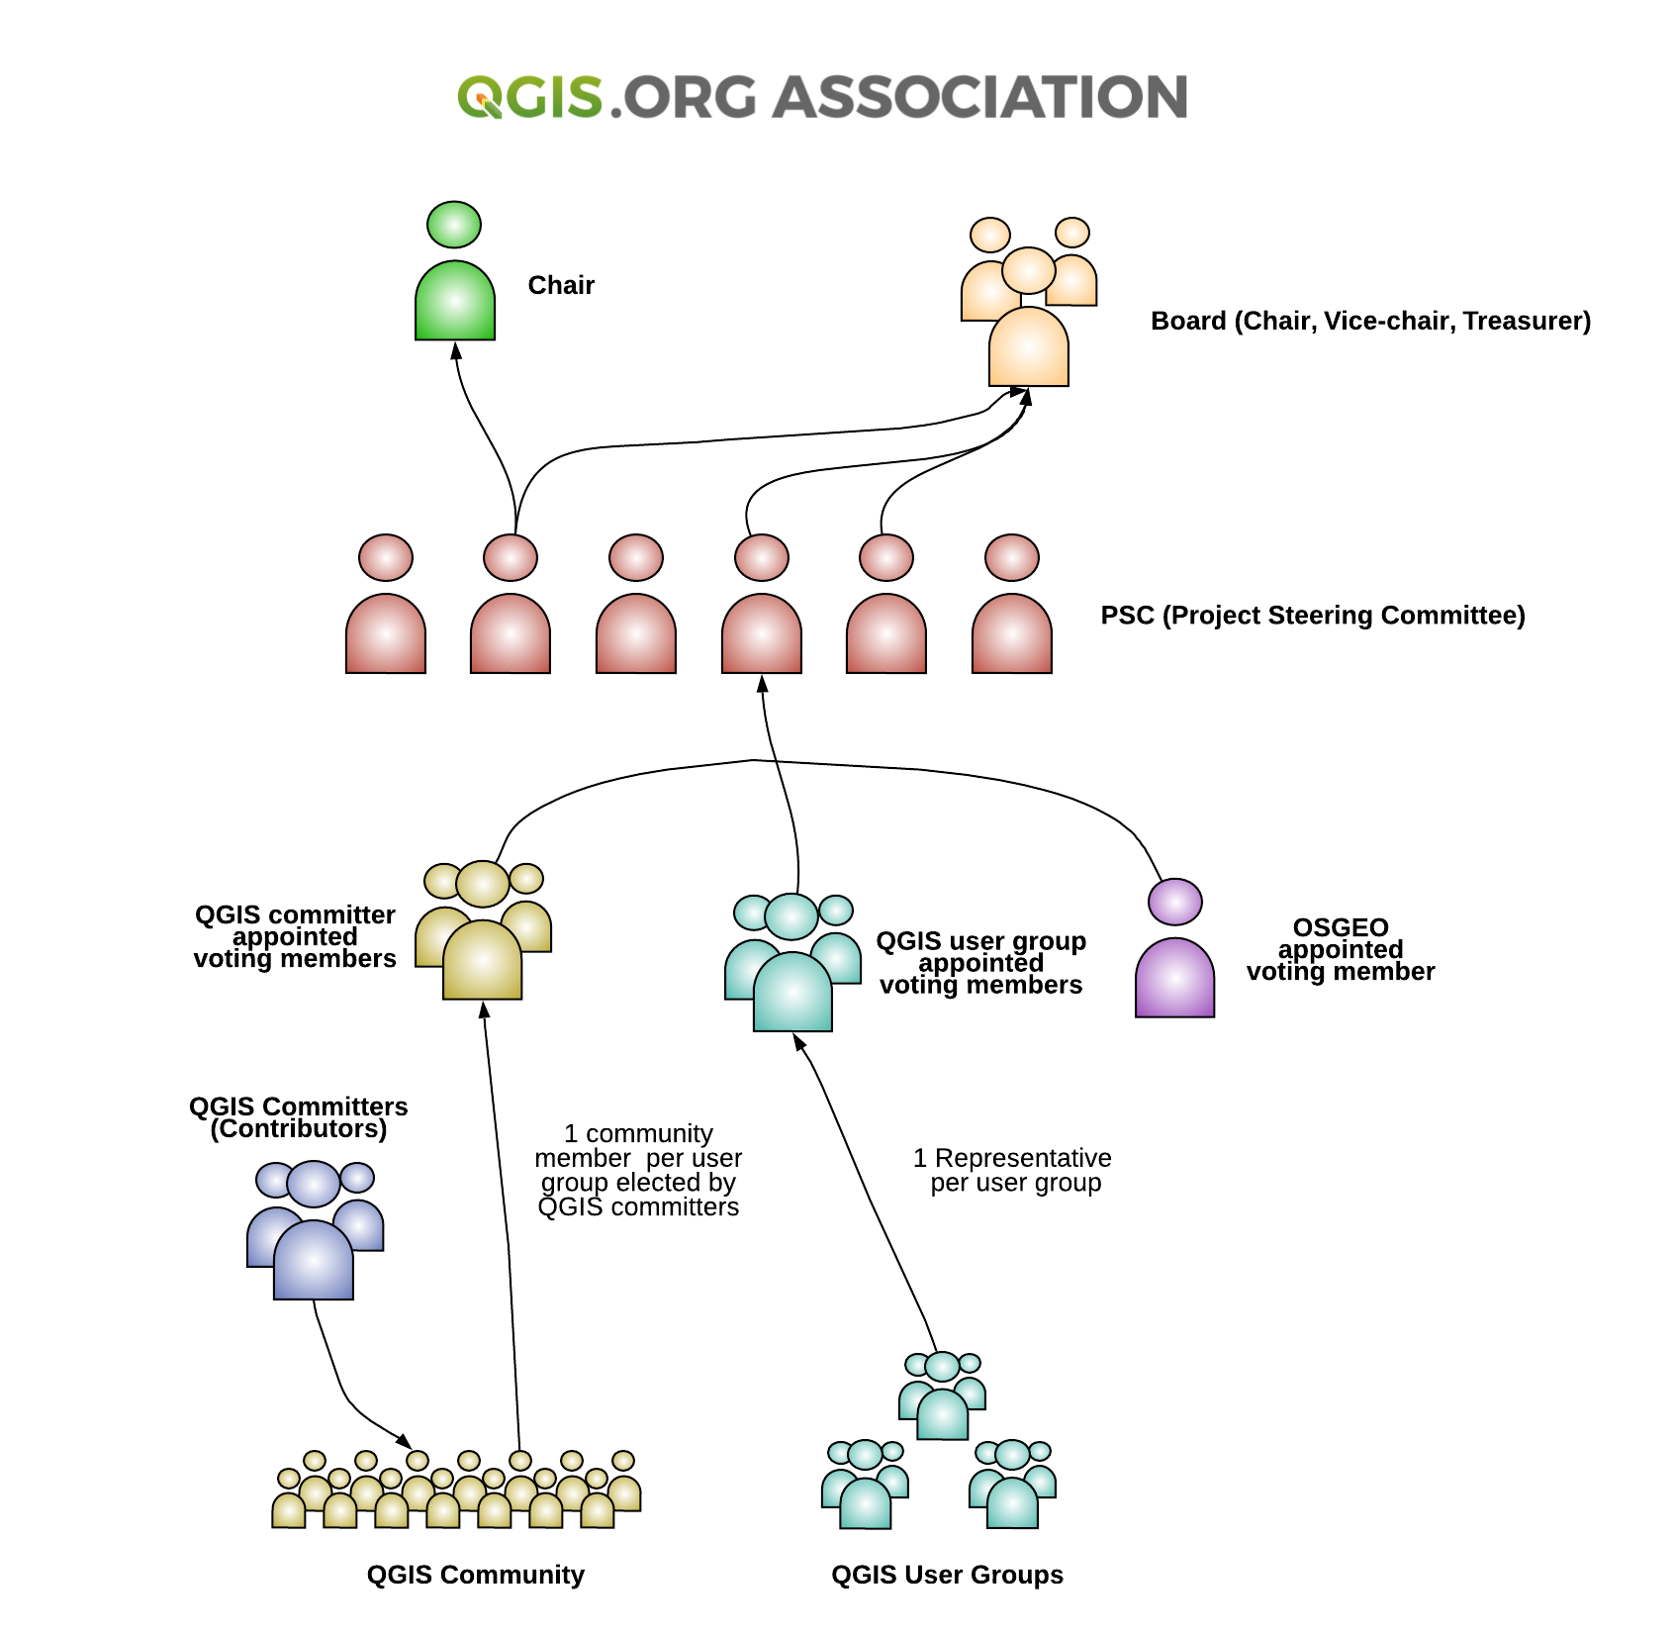
QGIS Organization
QGIS community
PSC
Board (subset of PSC)
= legal representation
Project working groups
Voting members
  User group voting members
  Community voting members
  OSGEO voting member

Slide 23
Voting members
Elect
  QGIS PSC
  QGIS Board
  QGIS Chair
  Financial Auditors
Decide on
  QGIS grant proposals
  Any other matters that need community decisions
Approve
  Yearly report of chair
  Financial report of past year
  Budget of upcoming year

Slide 24
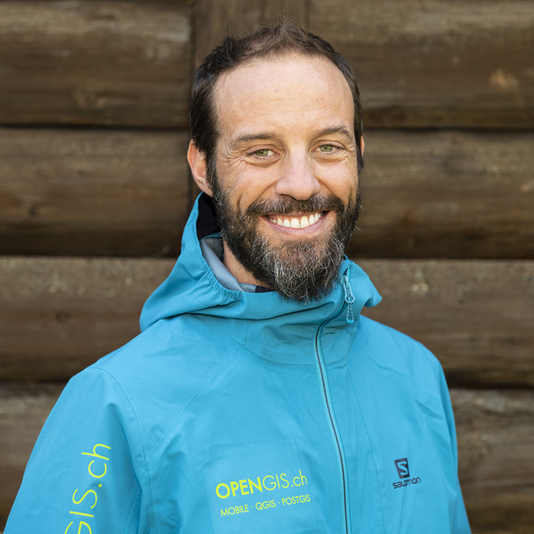

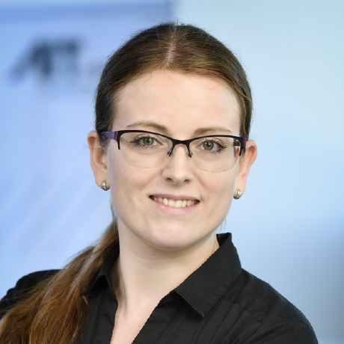
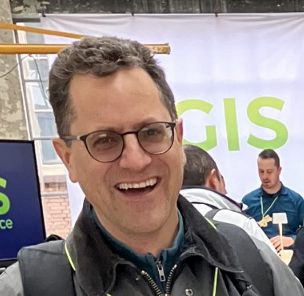




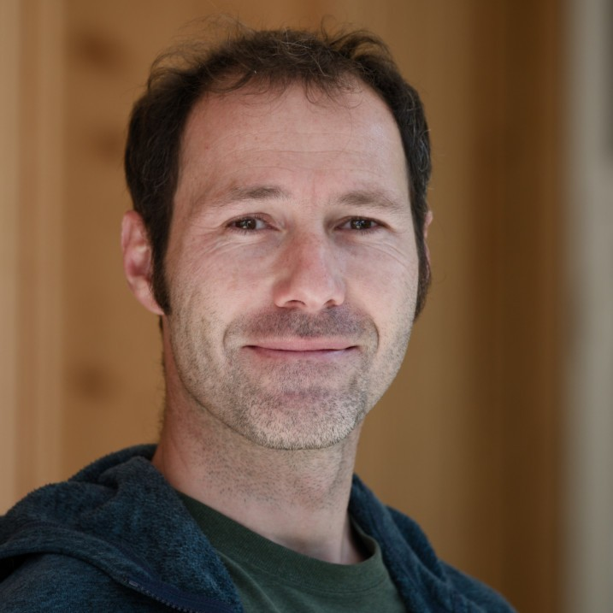

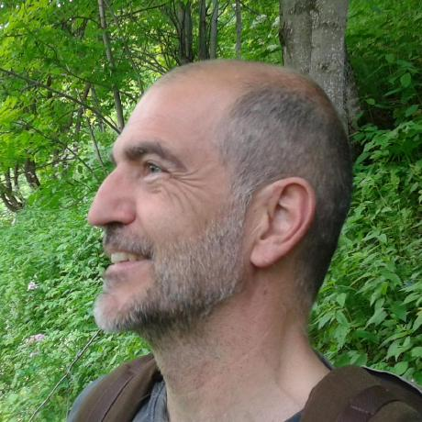





PSC & Honorary PSC Members
Marco Bernasocchi (Chair)
Anita Graser
(Vice-chair)
Andreas Neumann
(Treasurer)
Gary Sherman
(Project founder & honorary member)
Régis Hauburg
Alessandro Pasotti
Jürgen Fischer
Tim Sutton
(honorary)

Slide 25
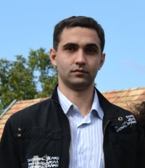

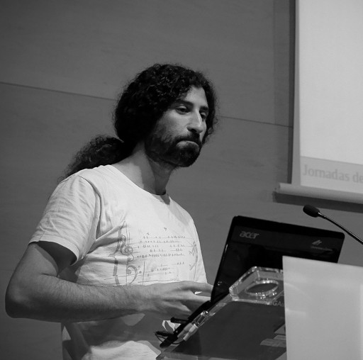


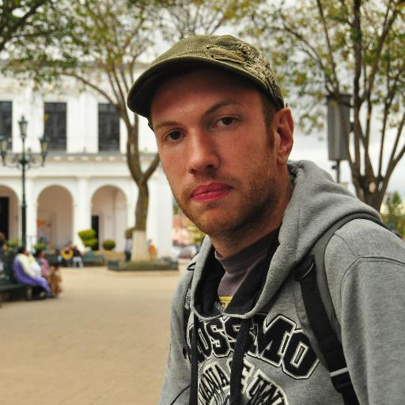

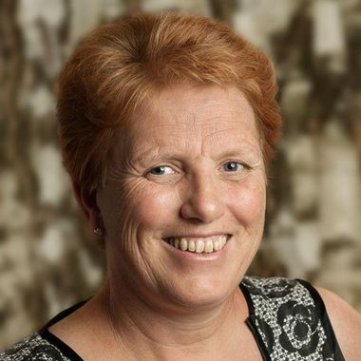
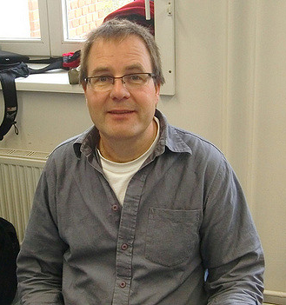
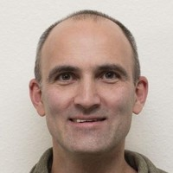
Other Contributors
Martin Dobias
Victor Olaya
Amy Burness
Alexander Bruy
Matthias Kuhn
Even Roualt
Raymond Nijssen
Nyall Dawson
Lene Fischer
Richard Duivenvoorde

Slide 26
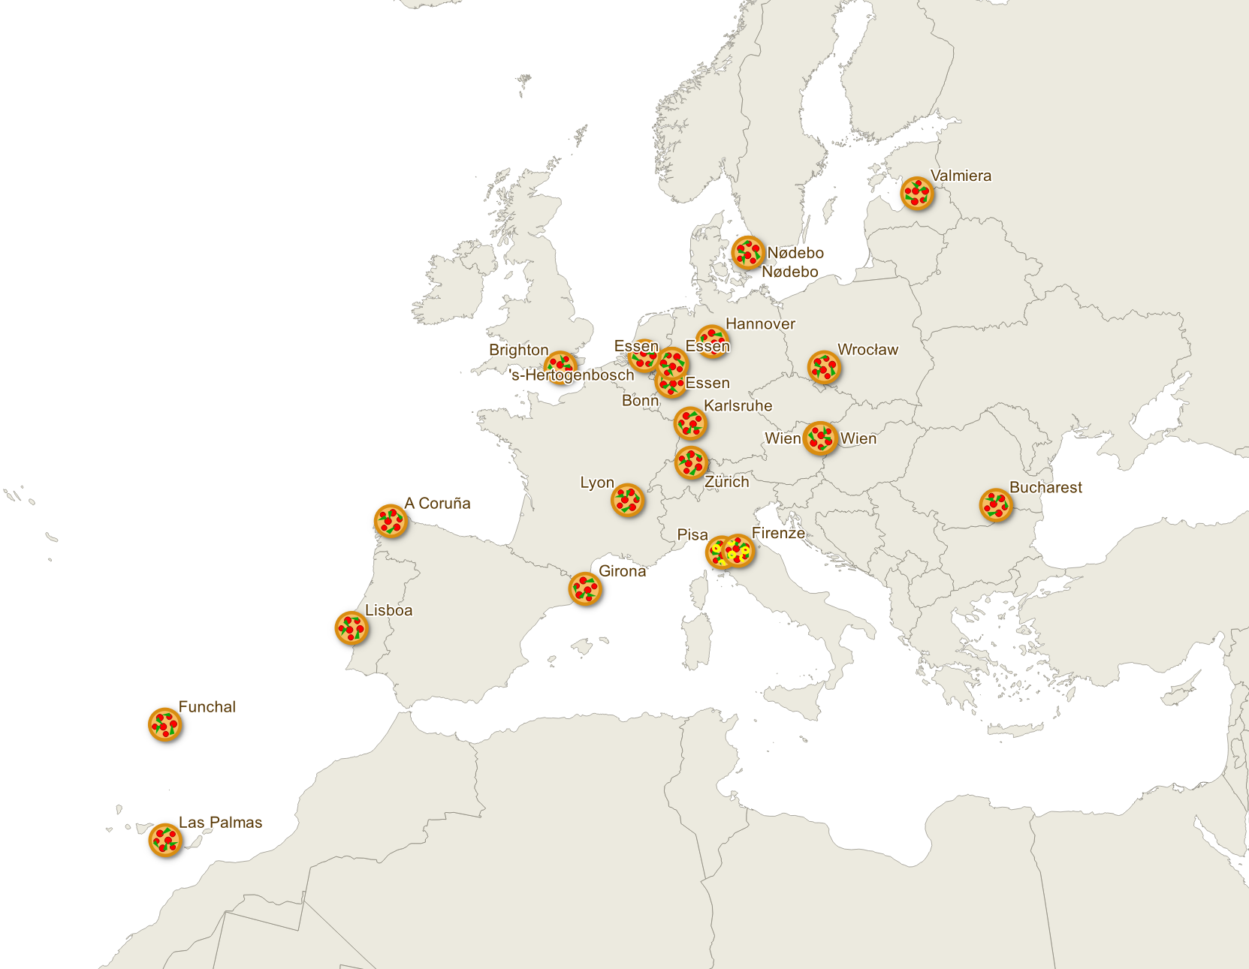
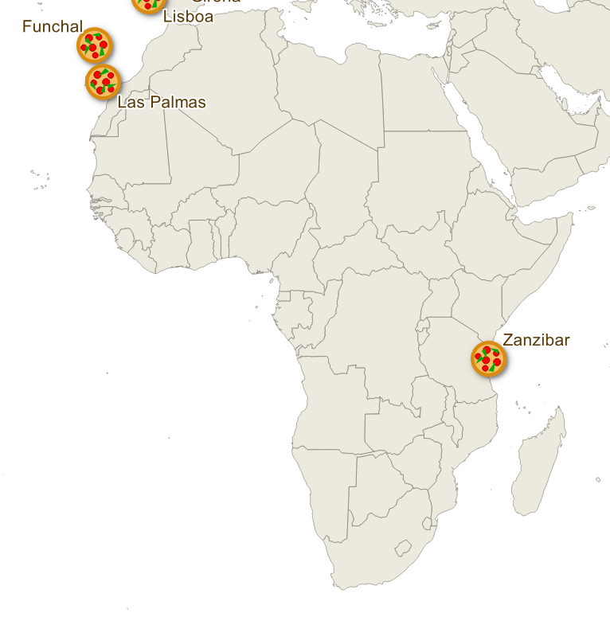
QGIS developer meetings

Slide 27
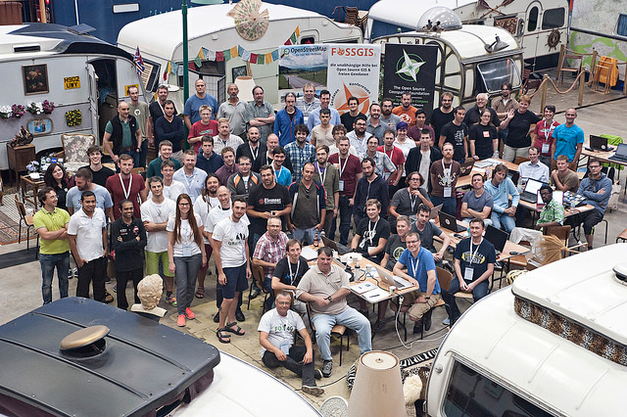
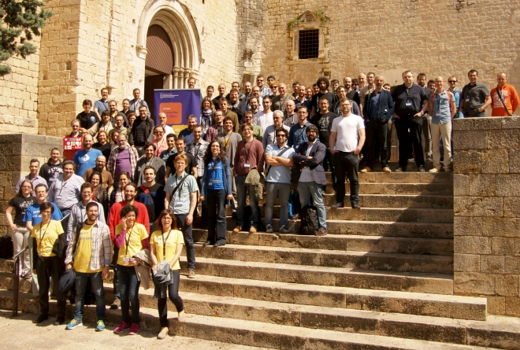
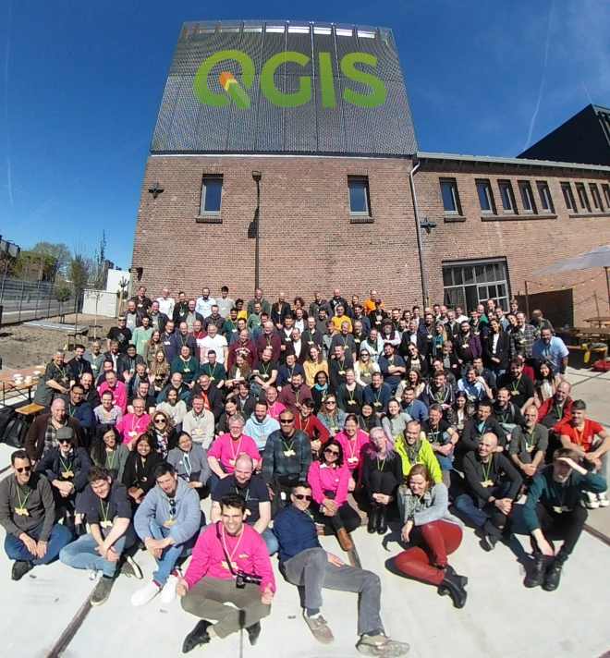
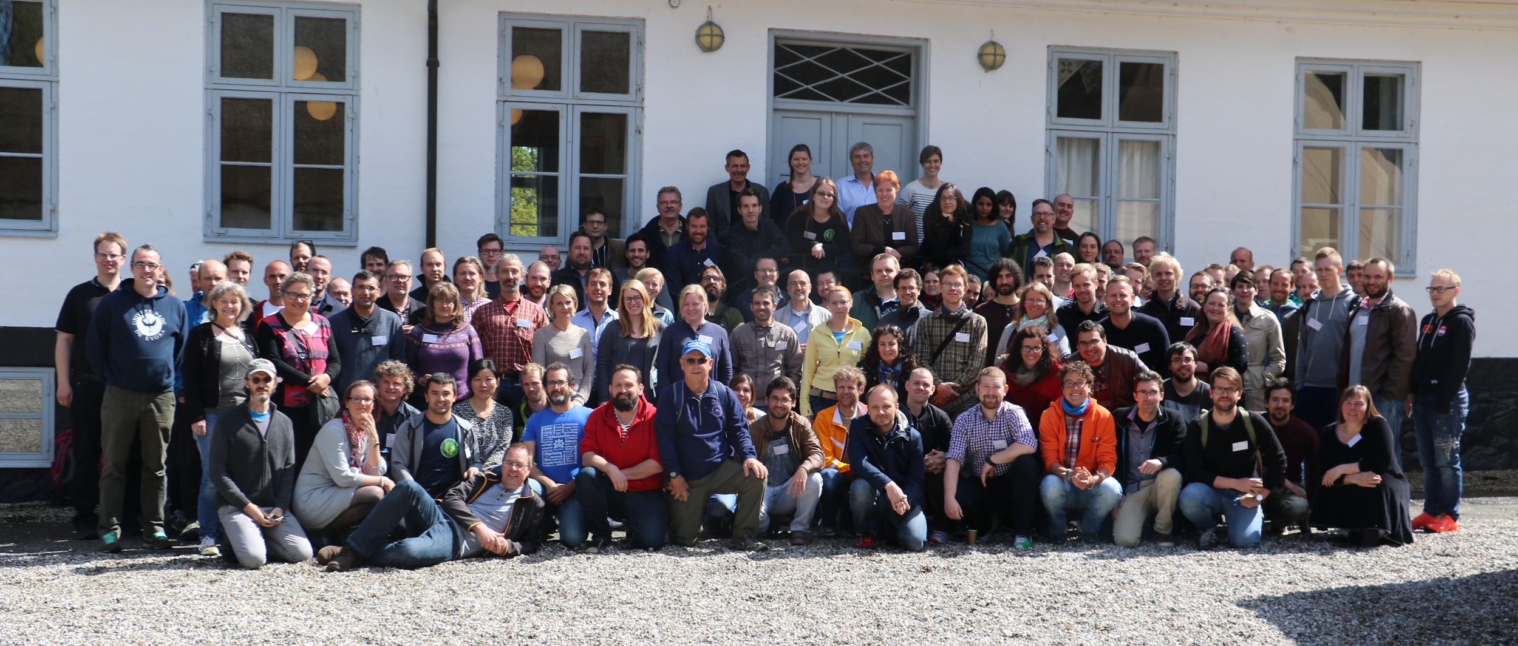
QGIS Contributor Meetings
& Conferences

Slide 28
Hosting a Contributor Meeting or Conference
Responsibilities:
Provide space, food and coffee for 40-50 developers
Venue should be relatively easy to reach from airports / train
Provide Wireless and enough power plugs
Organize dinner at an interesting local place
Find local event sponsors
Benefits:
Support QGIS project and coordination work
Get most important core devs and community members in one room for networking
Pick the next release name of QGIS!

Slide 29
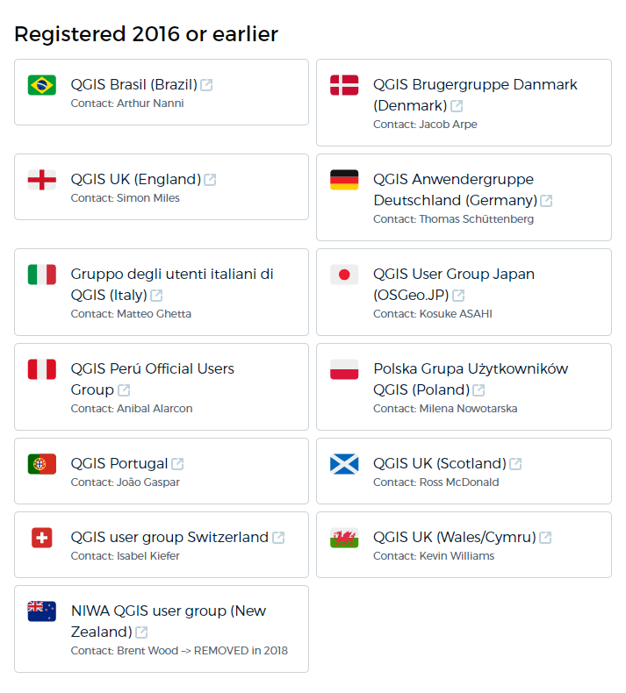
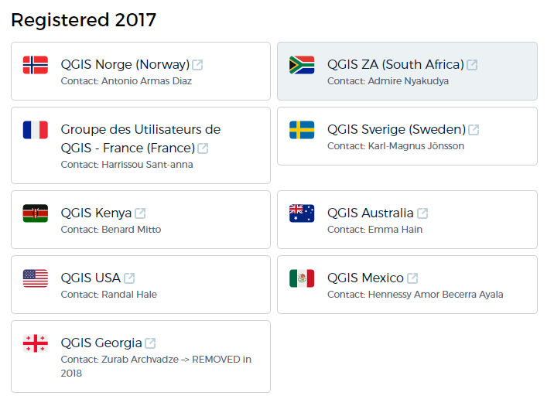
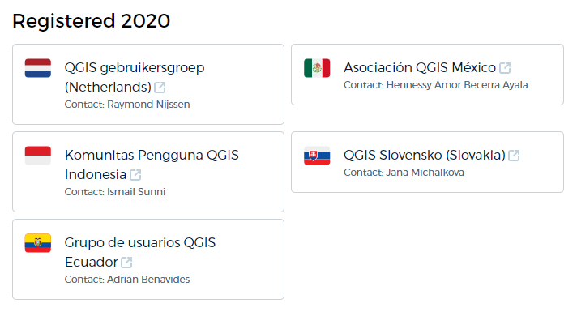
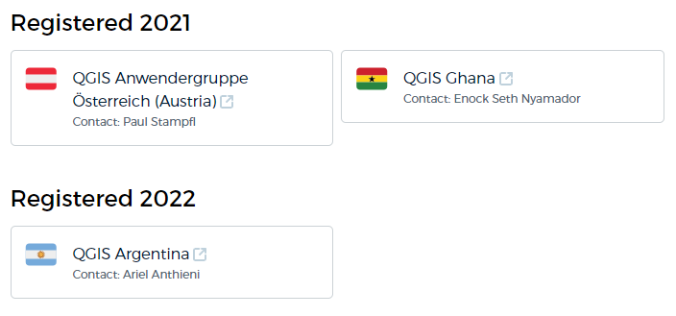
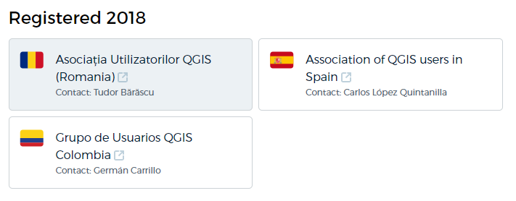
QGIS User Groups

Slide 30

QGIS User Groups: Local Ambassadors
Local representation of QGIS.ORG in your country
Organize user meetings and workshops
Collect case studies and best practice examples
Local networking and know-how exchange
Inform their members on “what’s going on at QGIS.ORG worldwide”
Share know-how and tips & tricks
Organize crowdfunding to cater to the needs of their members (or contribute globally)
Help sponsor QGIS.ORG

Slide 31
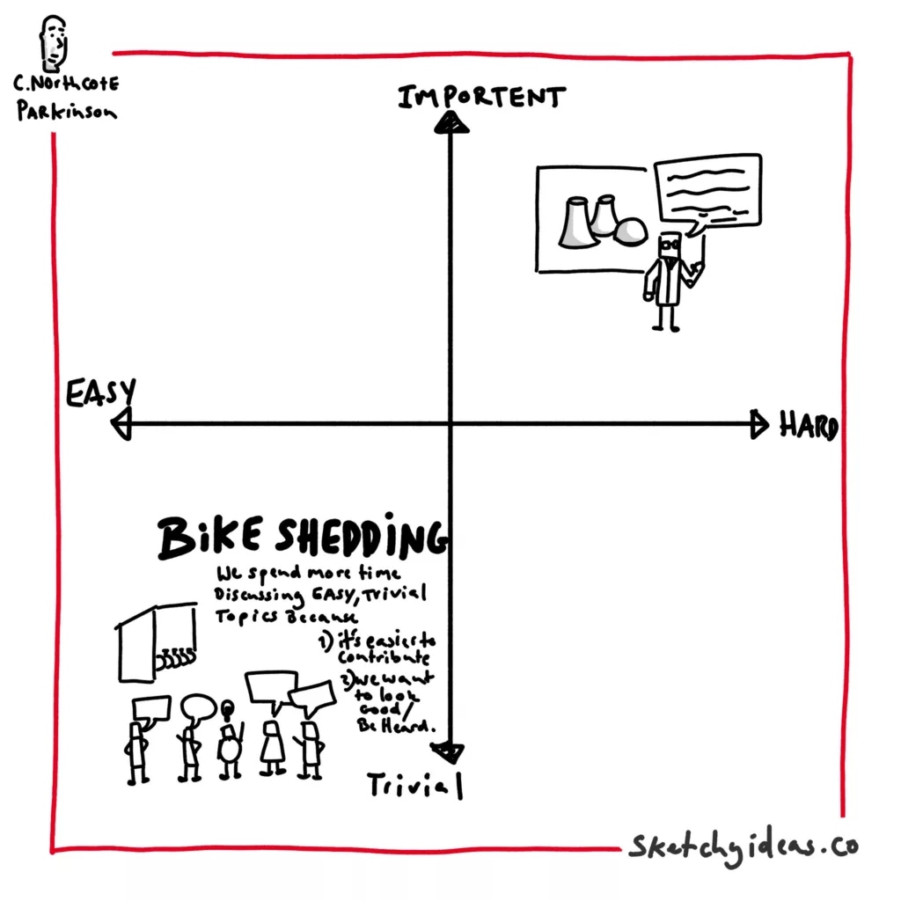
Challenges of QGIS as a Project
QGIS is developed “bottom up” – driven by users demands
QGIS devs run their own businesses / are employed by FOSS companies
Grass roots project decision making is … complicated
QGIS.ORG funds are quite limited
  Documentation (manual, API, Python cookbook)
  Very limited marketing resources
  QGIS.ORG only recently started building a full time support team
  Bug fixing & QA (see next slide)

Slide 32
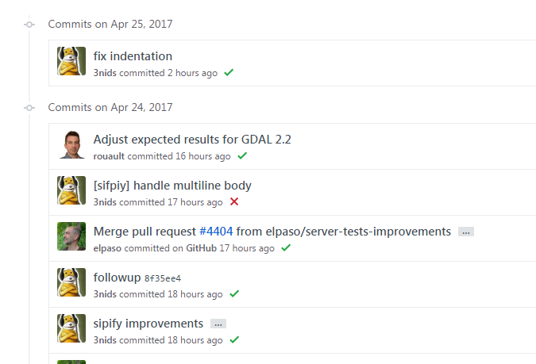
Quality Assurance
Unit tests required for core classes
  Also ask your dev to include unit tests in quotes
All changes are first made with git pull requests
Test suite for Processing
Automated code scans against race conditions (Coverity)
Continuous integration
  See green checkmark or red cross at Github
QEP (QGIS enhancement proposals):
  Proposals for larger changes with discussions
  https://github.com/qgis/QGIS-Enhancement-Proposals/issues
New QGIS devs
  Are mentored - Peer code reviews from core devs
  Devs need to agree to guidelines, esp. when they become core contributors

Slide 33
How to Get Your Bugs Fixed
& Features Implemented
Report your bug or feature request at https://github.com/qgis/qgis/issues
Don’t sit and wait, but either
  Fix the issue yourself
  Sponsor a developer to do the fix
  Sponsor / donate to QGIS.ORG → we do bug-fix rounds before every release
  If you can’t sponsor, help to start a crowdfunding initiative
If your business relies on QGIS, consider to place a support contract with a core QGIS developer - either at a fixed monthly price or by buying a package with support hours
See also: https://nyalldawson.net/2016/08/how-to-effectively-get-things-changed-in-qgis/ and http://nyalldawson.net/2016/08/how-to-effectively-get-things-changed-in-qgis-a-follow-up/

Slide 34
Commercial Support
Directly with companies
New features
  Always include tests
  Ideally account for an external review
Bug fixes
Training
Support contracts
...
https://qgis.org/resources/support/commercial-support/

Slide 35
Support - QGIS Mailing Lists
https://www.qgis.org/en/site/getinvolved/mailinglists.html
User
Developer
Community Team
PSC
QGIS Web Client 2

Slide 36

QGIS Open Days
Last Friday of Every Month
YouTube Playlist
https://www.youtube.com/playlist?list=PLi1f0_iZ5PCHlqkzW_Fc9k35lTSHpJ3Ya

Slide 37
Follow QGIS
On Mastodon: fosstodon.org/@qgis
On Github: github.com/qgis
Telegram Channel: https://t.me/joinchat/Aq2V5RPoxYYhXqUPoxRWPQ
Facebook – QGIS Group: https://www.facebook.com/QGIS-298112000235096/
→ or better be a part of QGIS!
What will you contribute?

